Slide 1
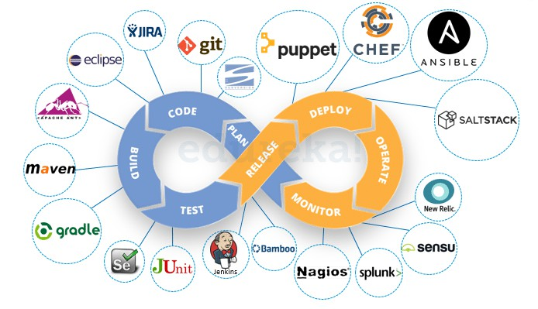
05-04-2025
Dr.S.Udhayakumar Associate Professor, Department of Computer Science and Engineering(Cyber Security)
Module 2 Why and What is DevOps?
About DevOps
RL2.2.1 Need for DevOps
RL2.2.2 Evolution of DevOps RL2.2.2 DevOps Practices
DevOps
Define the stages of a DevOps evolution
DevOps practices in organizations
The Continuous DevOps LifeCycle Process (Continuous Integration, Continuous Inspection,
Continuous Delivery, Continuous
Deployment, Continuous Monitoring)
Case Study- (IBM/Facebook/NetFlix)

Slide 2

05-04-2025
DevOps (Development and Operations)
DevOps (development and operations) is a collection of tools and technologies combined to carry out various business processes.
It aims to bridge the gap between two of the most significant departments
in any IT organization, the
development department,
and the
operations department.

Slide 3
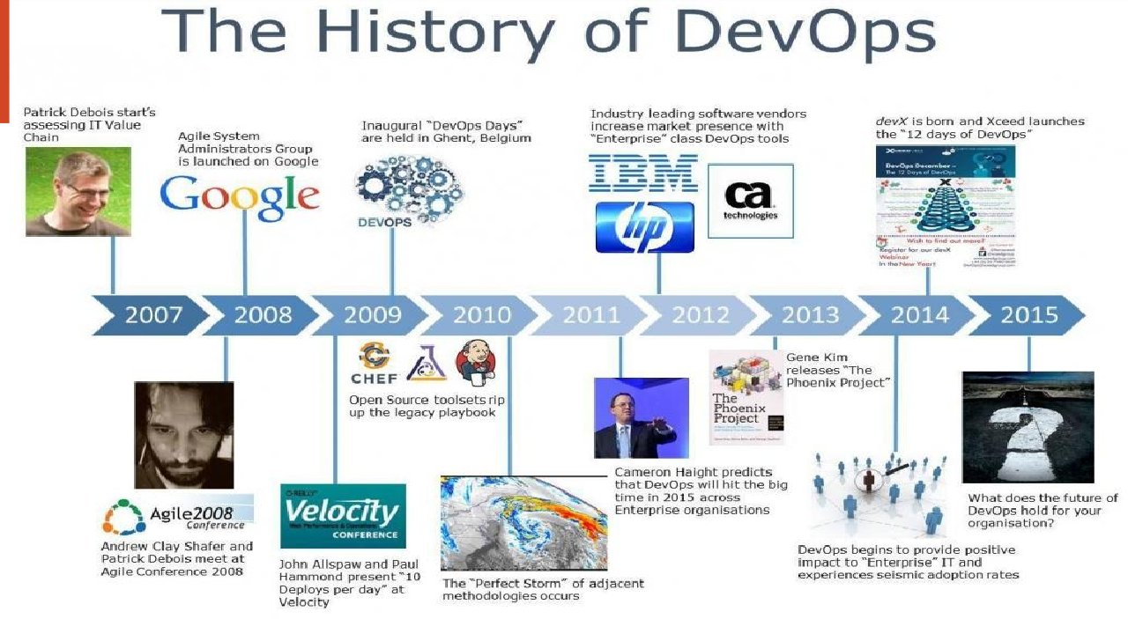
05-04-2025
History of DevOps
Before DevOps came into the limelight, IT had two separate teams in an organization – the Development team and the Operations team.
The development team worked on the software, developing it and making sure that the code worked perfectly.
After hours of hard work and a lot of trial and error, the team releases a code that has to be executed by the Operations team which is responsible for the release and operation of the code.
The operations team will be checking the application and its performance and reporting back any bugs, if present.

Slide 4
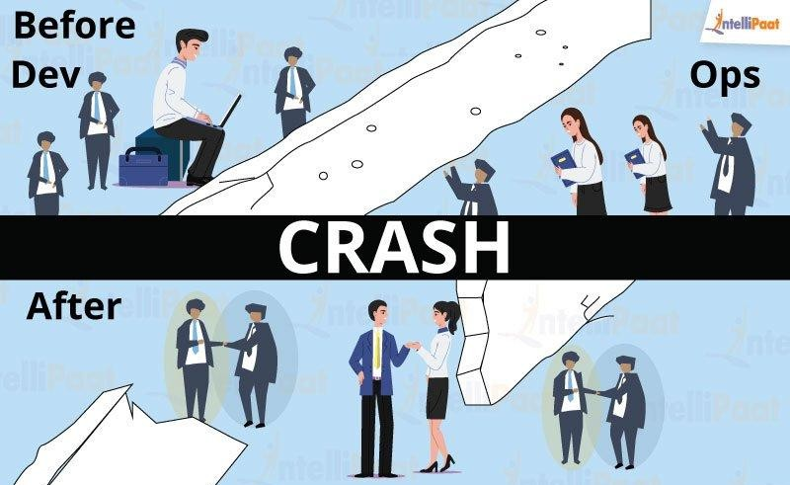
05-04-2025
Before DevOps – a scenario
As simple and planned out as it may sound, the two major teams always had a conflict when it came
to execution.
For instance, let us say, the development team developed a code using an i7 processor, 8GB RAM, OS as Ubuntu, and PHP 5.6 scripting language, whereas the Operations team ran the same code using i5 processor, 16GB RAM, OS as Centos and PHP 7.0 programming language.
When the operations team ran the same code, it wouldn’t work.
The reason for this could be the difference in the system environment or any missing software library.
The operations team flagged this code as faulty, even though the problem could exist in their own system. This resulted in a lot of back and forth between the Developers and the Operations team.

Slide 5


05-04-2025
After DevOps
To bridge this gap, Development(‘Dev’) team and Operations (‘Ops’) team collaborated giving rise
to DevOps.
For example, to solve the above problem, the Development team encapsulated their code in a
container which is a lightweight software environment.
This software environment had all the required software encapsulated in it, which the code or the application will require to run as expected.
When the developers were done with their work, they would simply pass on this container along with the code to the operations team.
The Ops will run this container, along with the code, and it worked as expected!
What is DevOps?
DevOps is not a tool or a team, it is the process or a methodology of using various tools to solve the problems between Developers and Operations team, hence the term “Dev-Ops”
The development team always had the pressure of completing the old, pending work that was considered faulty by the operations team. With DevOps, there is no wait time to deploy the code and get it tested.
Hence, the developer gets instantaneous feedback on the code, and therefore can close the bugs, and can make the code production ready faster!

Slide 6
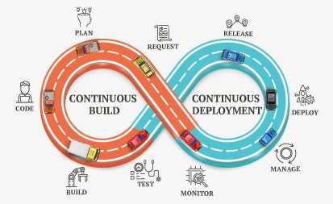
05-04-2025
DevOps
It is a philosophy that encourages adopting iterative software development, automation, and programmable infrastructure deployment and maintenance.
DevOps emphasizes building trust and better liasioning between developers and system administrators.
This helps the organization in aligning technological projects to business requirements.
Changes rolled out are usually small and reversible, which the entire team begins to comprehend.
The infinite Loop
DevOps is visualized as an infinite loop comprising the steps: plan, code, build, test, release,
deploy, operate, monitor, then back to plan, and so on.

Slide 7
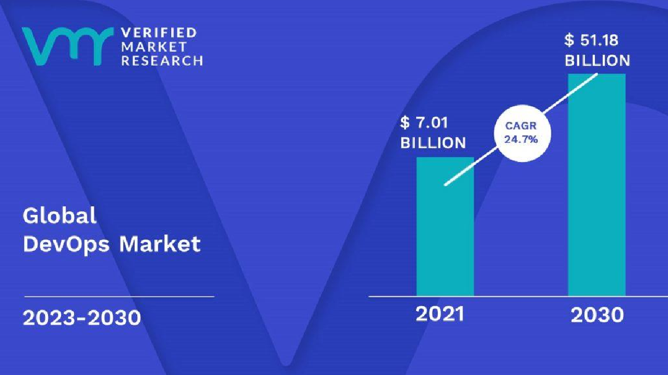
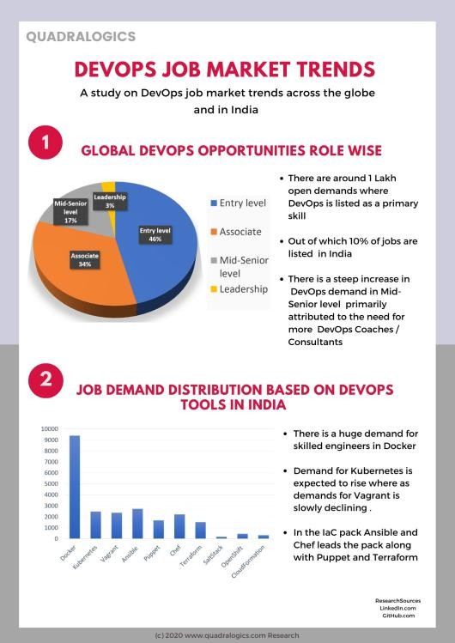
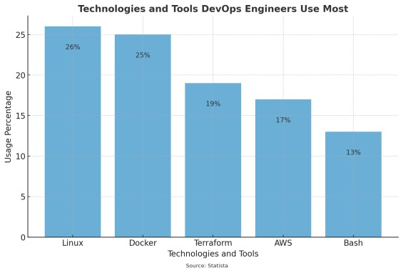
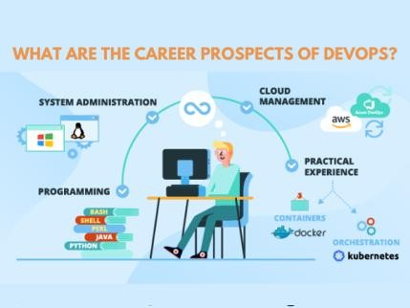
05-04-2025

Slide 8

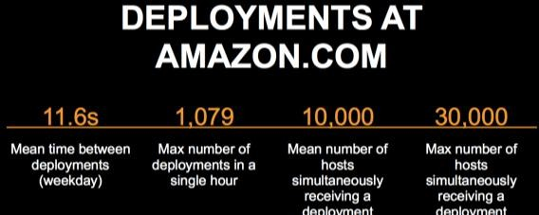
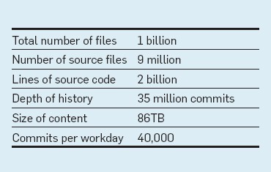

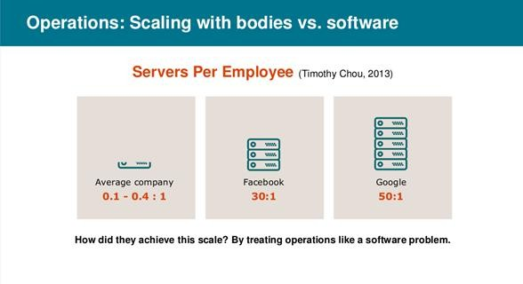


05-04-2025
Evolution of DevOps- Define the stages
of a DevOps evolution
BITS Pilani, Pilani Campus
Evolution of DevOps- Define the stages of a DevOps evolution
BITS Pilani, Pilani Campus

Slide 9
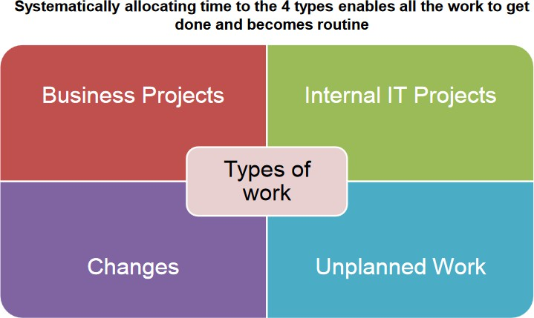
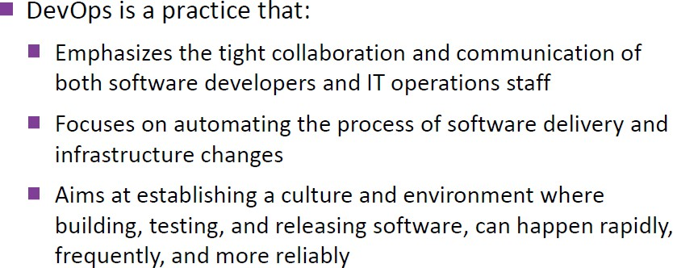
05-04-2025
DevOps practices in organizations
BITS Pilani, Pilani Campus
The Practice
BITS Pilani, Pilani Campus

Slide 10
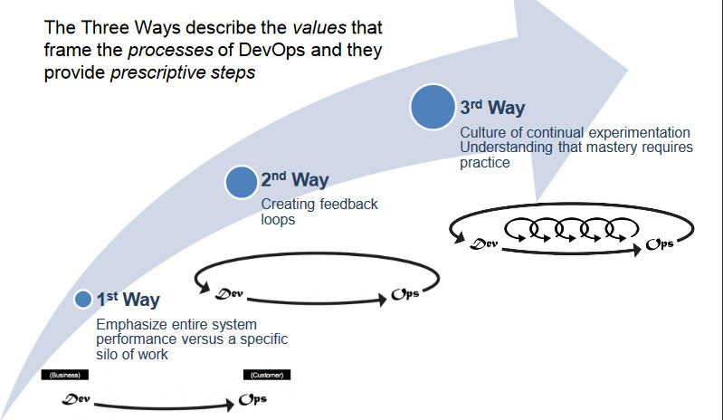
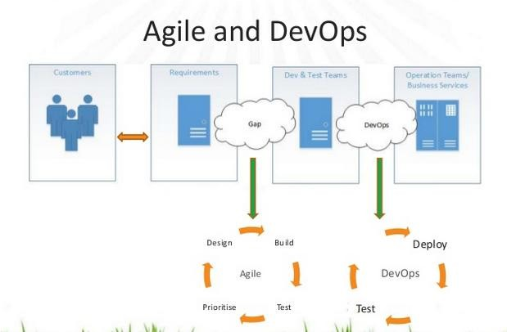
05-04-2025
How it works
BITS Pilani, Pilani Campus
Agile and DevOps
BITS Pilani, Pilani Campus

Slide 11
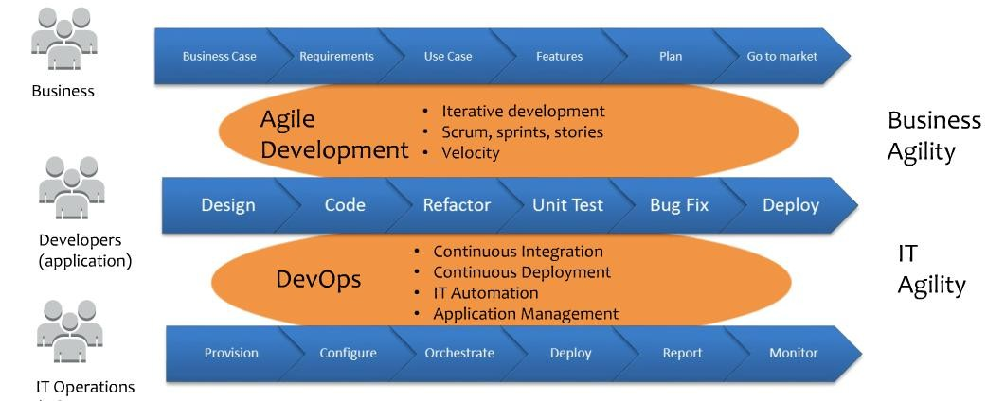
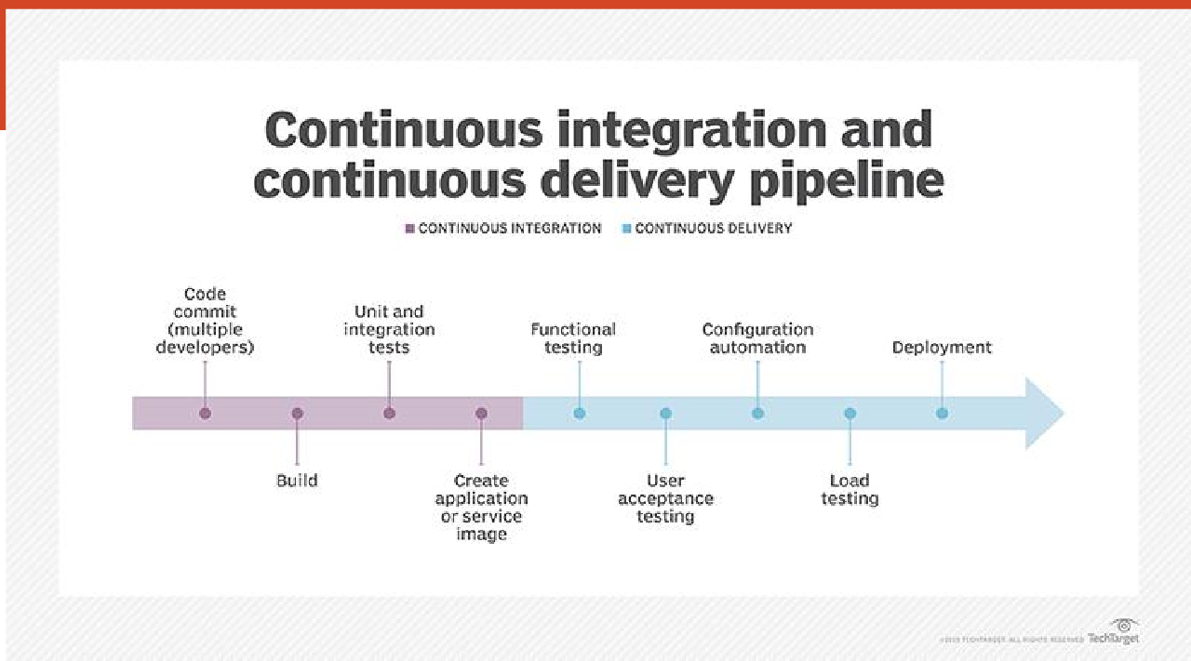
05-04-2025
Agile and DevOps
BITS Pilani, Pilani Campus

Slide 12
05-04-2025
1.BUILD AUTOMATION
An automated code is prepared to be deployed in a live environment where the tool used is tied to the programming language chosen.
This makes the whole process faster, consistent and more repeatable.
Further, it also ensures that your process is more reliable than any manual build.
2. CI/ CD – Continuous Integration and Continuous Deployment
CI/ CD – Continuous Integration and Continuous Deployment deals with frequent merging of codes and unit testing.
Further, the deployment of small code changes in a routine and frequent process is also a part of this method.
CI/CD helps massively as it helps you detect bugs early and maintains the use of modular code with minimal effort. It also reduces the time to market and introduces reliable rollbacks.

Slide 13
05-04-2025
3. INFRASTRUCTURE AS CODE
INFRASTRUCTURE AS CODE – This is usually to manage and provision IT infrastructure through code and automation.
This is reusable, and helps in consistent resource creation and management.
Furthermore, the infrastructure is self-documenting and simplifies complex material like authentication and application servers.
4. CONFIGURATION MANAGEMENT
CONFIGURATION MANAGEMENT – This is the process where you can manage and change the state of infrastructure in constant and maintainable ways.
This way, you end up saving a lot of time while also minimizing configuration drift, especially in large server environments.
Configuration Management also helps provide insight documentation on infrastructure.

Slide 14
05-04-2025
5. ORCHESTRATION
ORCHESTRATION – Orchestration is nothing but an automation that supports processes and workflows, like Resource Planning.
It not only helps you save time, but you also achieve stability, especially with an automatic response to detection of various problems.
6. MONITORING
MONITORING – By this method, you collect and present data about the performance and stability of services and infrastructure, while also detecting problems.
This enables faster recovery, helps with cross-team visibility, provides more data to analyze for better root-cause analysis and also generates an automated response.

Slide 15
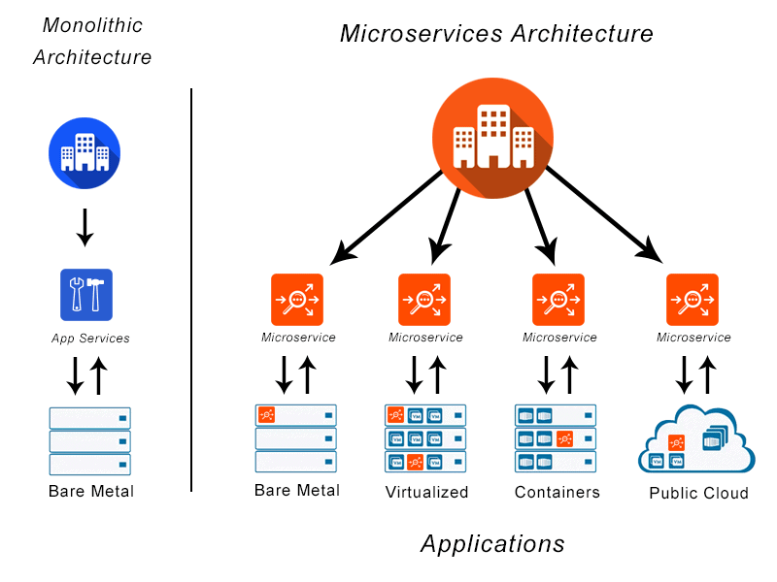
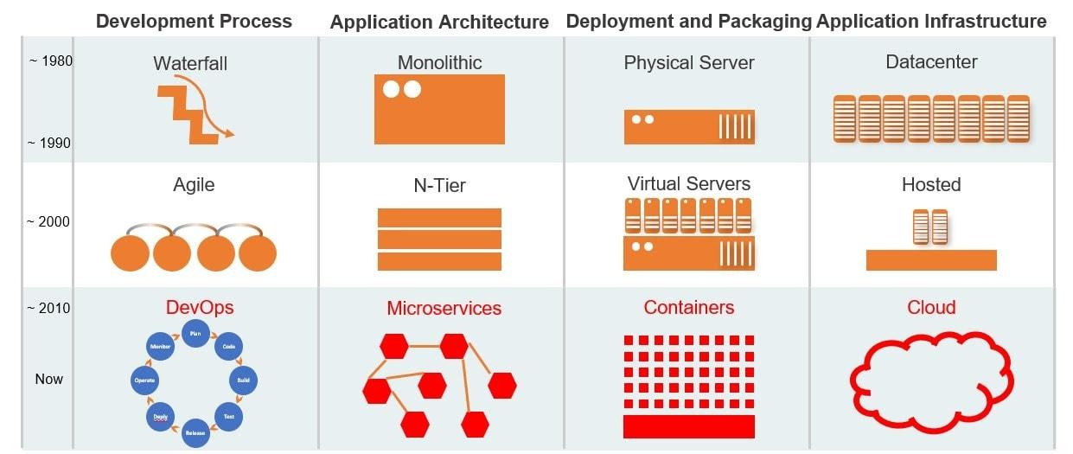
05-04-2025
7. MICROSERVICES
MICROSERVICES – It is basically an architecture that breaks an application into many small and loosely collected services.
This way, you end up reducing complexity and increase flexibility in choice of technology.

Slide 16
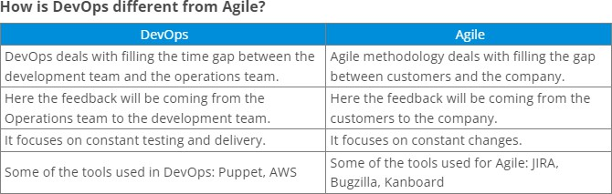
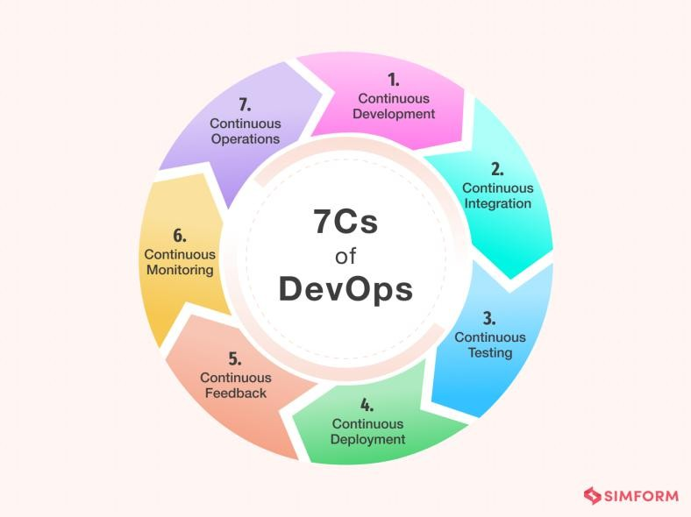
05-04-2025
The 7 key practices of DevOps are :
Configuration Management.
Continuous Integration.
Automated Testing.
Infrastructure as Code.
Continuous Delivery.
Continuous Deployment.
Continuous Monitoring.

Slide 17
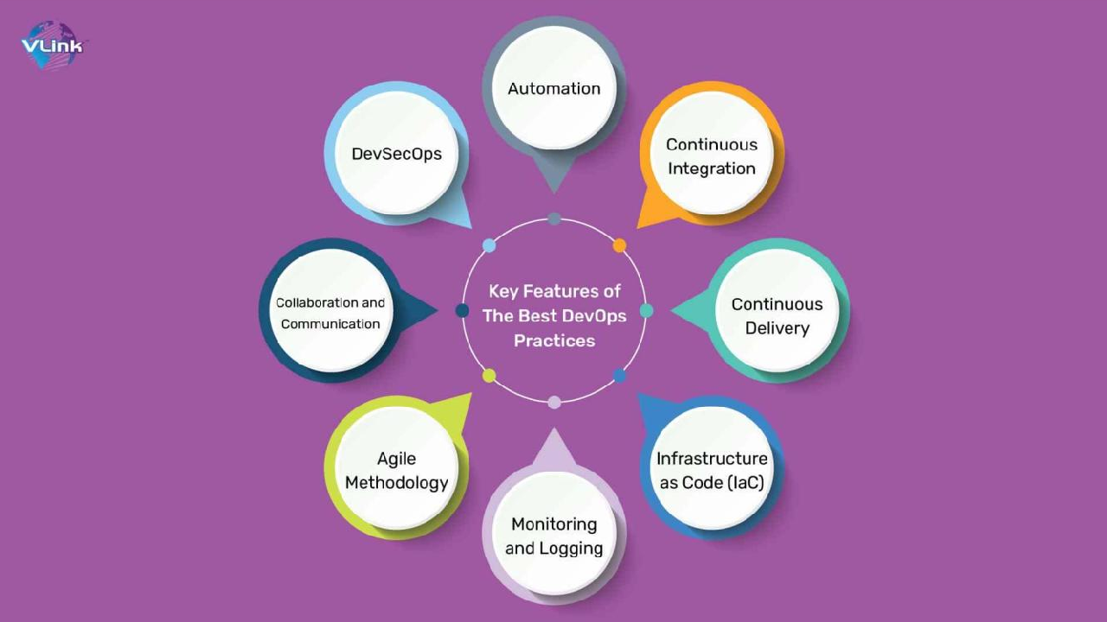
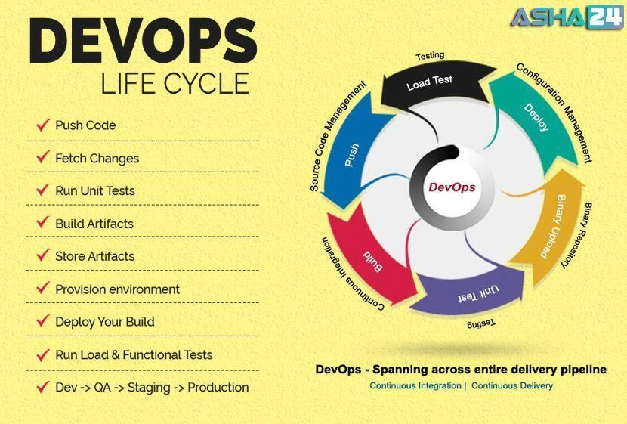
05-04-2025
The Continuous DevOps LifeCycle Process
BITS Pilani, Pilani Campus

Slide 18
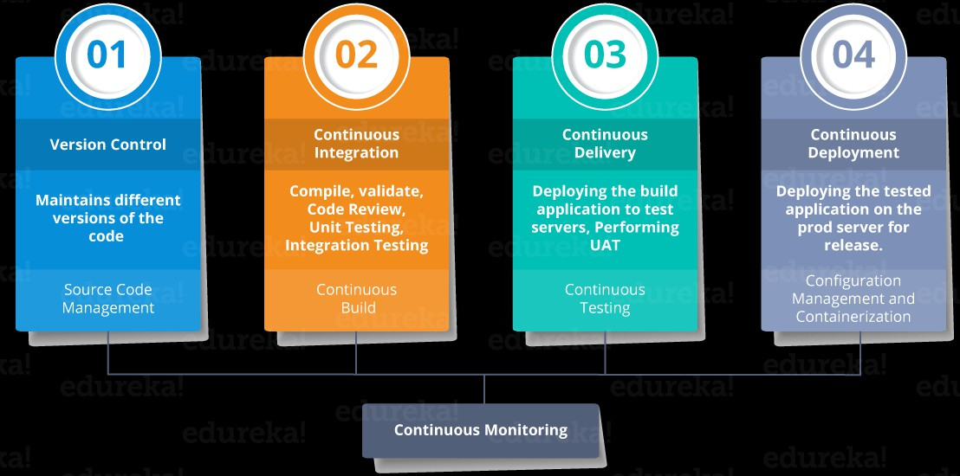
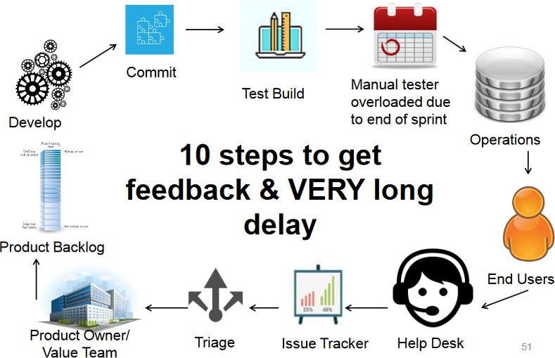
05-04-2025
DevOps Lifecycle Processes
BITS Pilani, Pilani Campus
Continuous Integration,
BITS Pilani, Pilani Campus

Slide 19
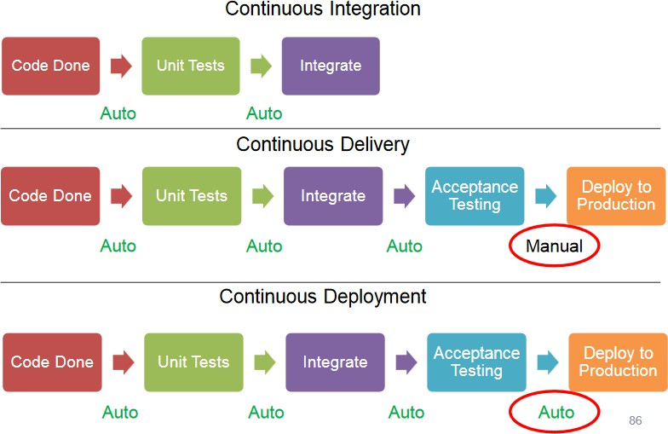
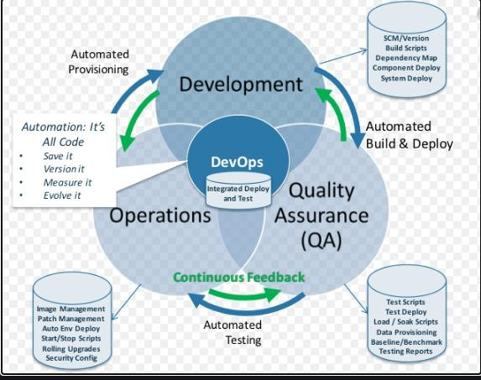
05-04-2025
Continuous Inspection,
BITS Pilani, Pilani Campus
Continuous Deployment,
BITS Pilani, Pilani Campus

Slide 20
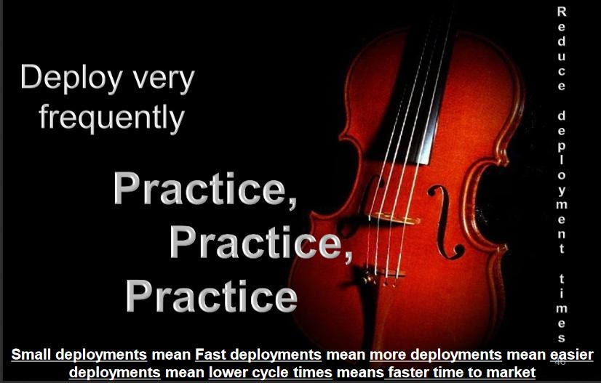
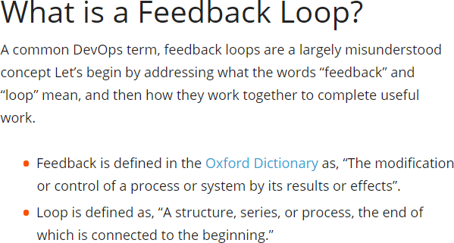
05-04-2025
Continuous Delivery,
BITS Pilani, Pilani Campus
Continuous Monitoring
BITS Pilani, Pilani Campus

Slide 21
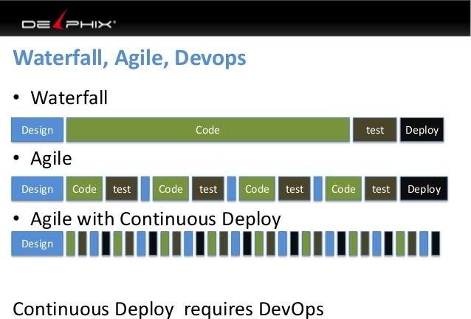
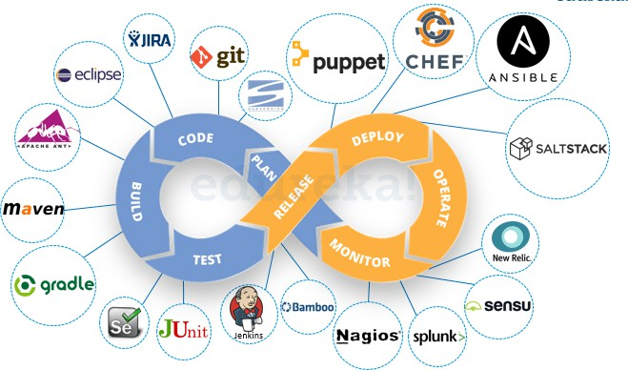
05-04-2025
DevOps Culture
BITS Pilani, Pilani Campus
Continuous Integration, Continuous Inspection, Continuous Deployment, Continuous Delivery, Continuous Monitoring)
BITS Pilani, Pilani Campus

Slide 22
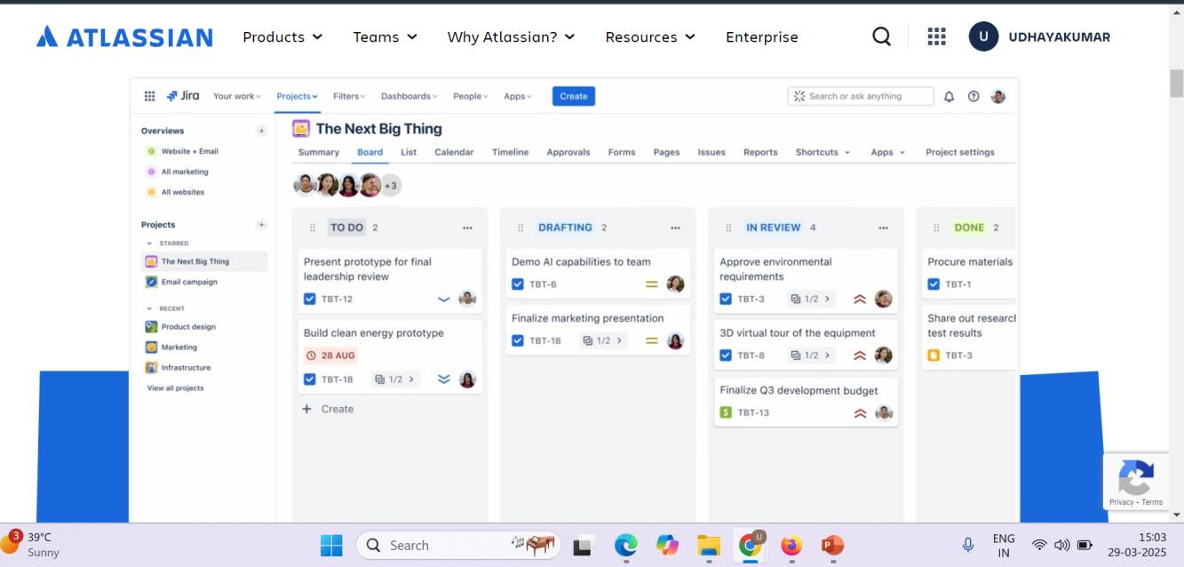
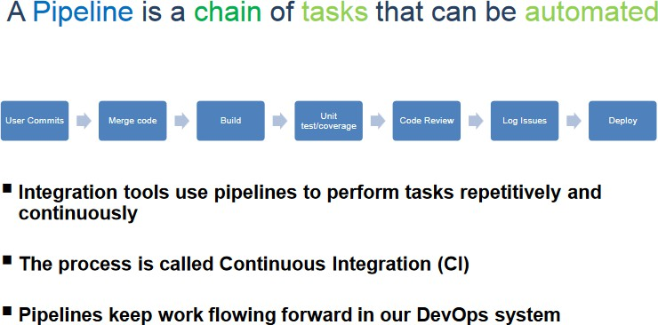
05-04-2025
BITS Pilani, Pilani Campus
DevOps Pipeline
BITS Pilani, Pilani Campus

Slide 23
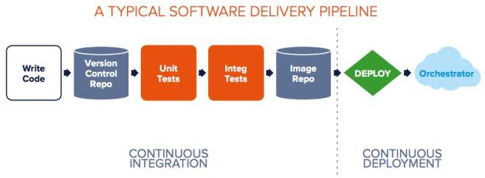
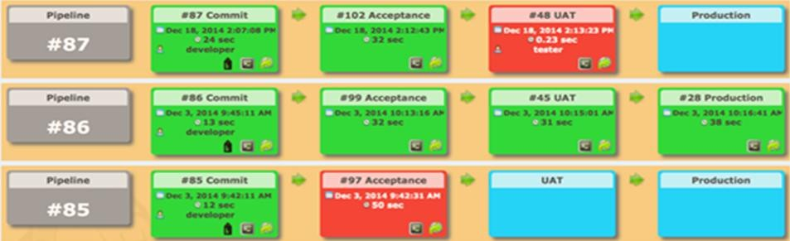


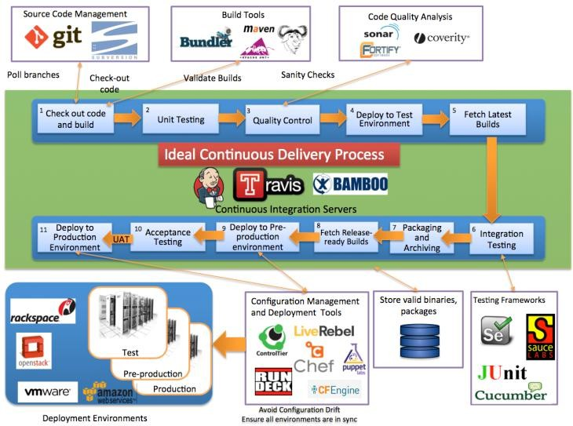
05-04-2025
Typical Case Study
Delivery pipeline is an automated manifestation of your process for getting software from version control into the hands of your users.
45
BITS Pilani, Pilani Campus
Case Study
DevOps Tools
46
BITS Pilani, Pilani Campus

Slide 24
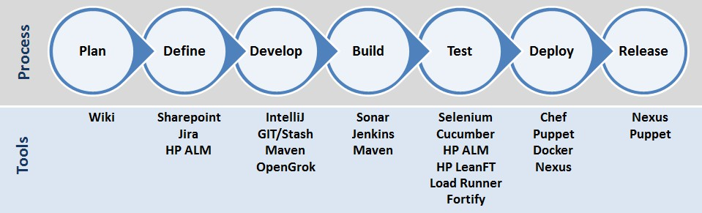
05-04-2025
Case Study
BITS Pilani, Pilani Campus
Release Antipatterns
Common Quote “The day of a software release tends to be a tense one”
Antipattern: Deploying Software Manually
The production of extensive and detailed documentation for steps to be performed
Reliance on manual testing
Frequent calls to the development team to explain
Frequent corrections to the release process
Sitting bleary-eyed in front of a monitor at 2 A.M
BITS Pilani, Pilani Campus

Slide 25
Problems of Delivering Software
05-04-2025
Release Antipatterns Cond..
Antipattern: Deploying to a Production-like Environment Only after Development Is Complete
Tester tested the system on development machines
Releasing into staging is the first time that operations people interact with the new release
Who Assembles? The Development Team
Collaboration between development and Operations?
Antipattern: Manual Configuration Management of Production Environments
Difference in Deployment to Stage and Production
Different host behave differently
Long time to prepare an environment
Cannot step back to an earlier configuration of a system
Modification to Configuration Directly
BITS Pilani, Pilani Campus
Five different categories of DevOps practices
Treat Ops as first-class citizens from the point of view of requirements
Make Dev more responsible for relevant incident handling
Enforce the deployment process used by all, including
Dev and Ops personnel
Use continuous deployment
Develop infrastructure code, such as deployment scripts
BITS Pilani, Pilani Campus

Slide 26
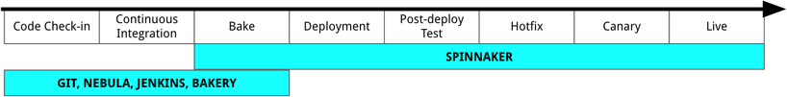
05-04-2025
Principle of Continuous
Delivery
Create a Repeatable, Reliable Process for Releasing Software Automate Almost Everything
Keep Everything in Version Control
If It Hurts, Do It More Frequently, and Bring the Pain Forward Build Quality In
“The Earlier you catch the defects, the cheaper they are to fix” Done, Means Released
Everybody Is Responsible for the Delivery Process
Continuous Improvement
BITS Pilani, Pilani Campus
NetFlix
https://netflixtechblog.com/how-we-build- code-at-netflix-c5d9bd727f15
BITS Pilani, Pilani Campus

Slide 27
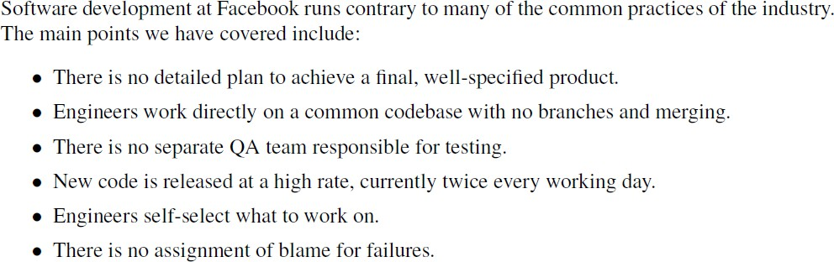
05-04-2025
Facebook
https://netflixtechblog.com/how-we-build-code-at-netflix-c5d9bd727f15
BITS Pilani, Pilani Campus
Facebook
BITS Pilani, Pilani Campus

Slide 28
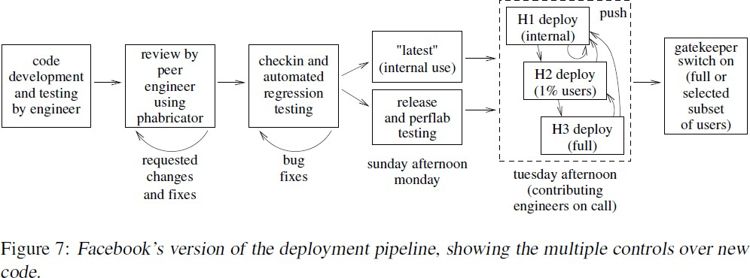
05-04-2025
facebook
BITS Pilani, Pilani Campus
5 trends that are influencing the adoptions of DevOps
The DevOps process involves an amalgamation of software development and IT operations. The major objective is to reduce the system’s development life cycle, which can provide high software quality along with continuous delivery.
Monolithic to Microservice Architecture Cloud as default
Release and deployment automation Agile infrastructure
AI and ML

Slide 29
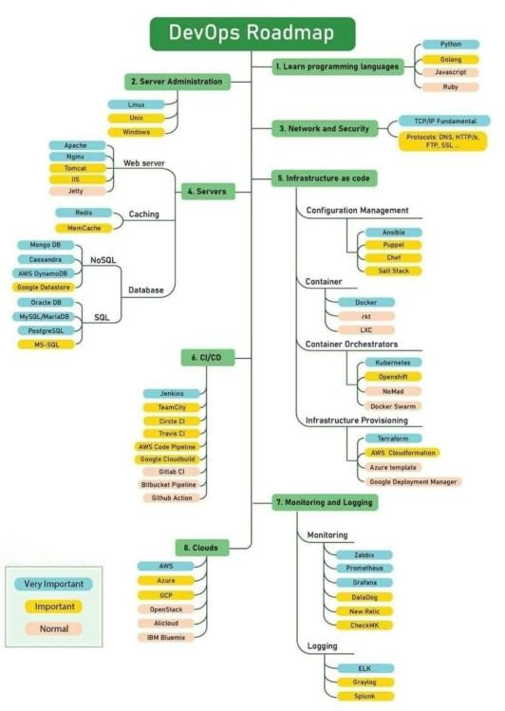
05-04-2025
In DevOps multiple tools are used few of them are:
Git - For Version control system
React/Flask/Django or any other webframework or techsta k - For building web app
Docker - For Containerizing , Building image, deployment.
Kubernetes - For Management of containers.
GitHub/Gitlab - For CI/CD(Continuous Integration/Continuous Deployment)

Slide 30
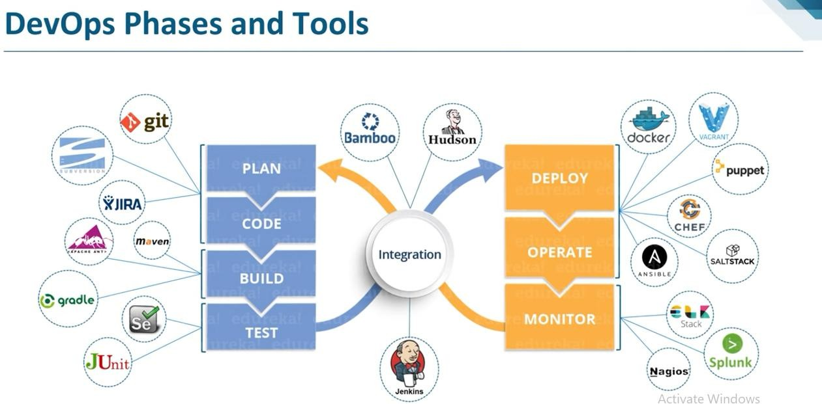
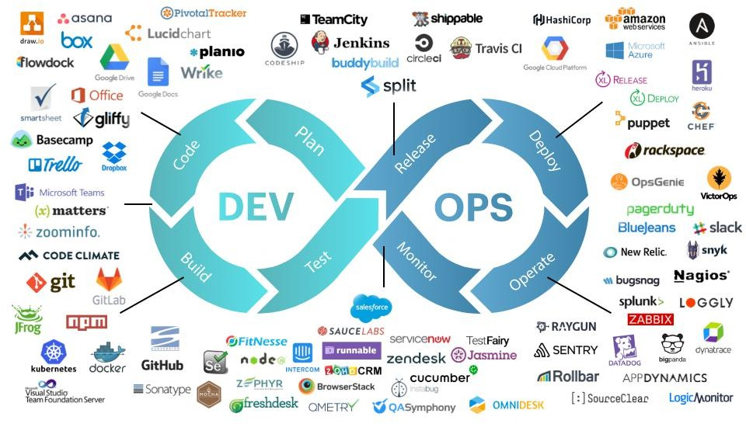
05-04-2025

